Slide 1
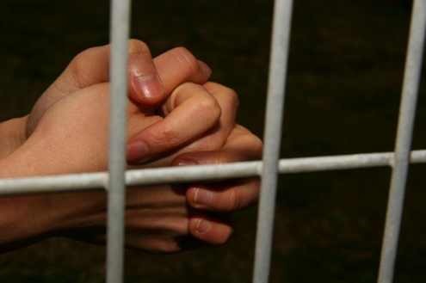
Suffering Yet Steadfast
The Church of Smyrna (Rev. 2:8-11)
Rick Griffith • Crossroads International Church • BibleStudyDownloads.org

Slide 2
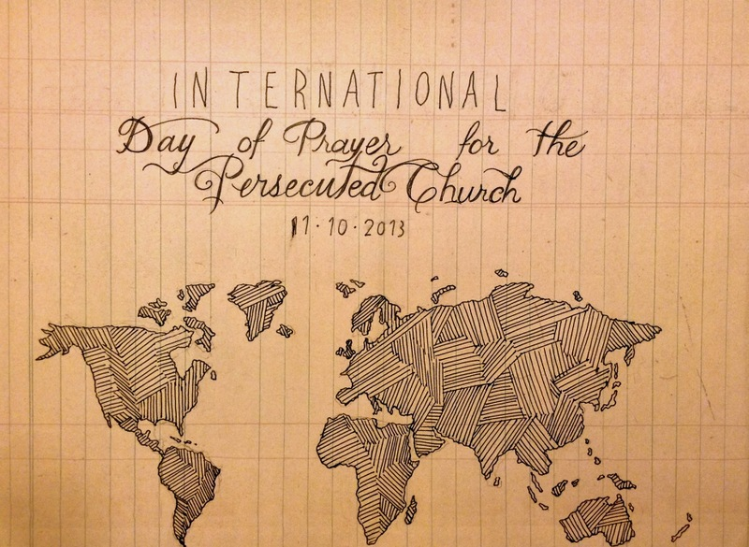
IDOP
International Day of Prayer for the Persecuted Church 10 Nov 2013
Notes:
Today and last Sunday, over one half million churches around the globe commemorate the International Day of Prayer for the Persecuted Church. We stand with them and have designed our entire service to remember our suffering brothers and sisters who lose property, livelihood, and loved ones—yes, who lose even life itself—simply due to their faith in our Lord Jesus Christ.

Slide 3
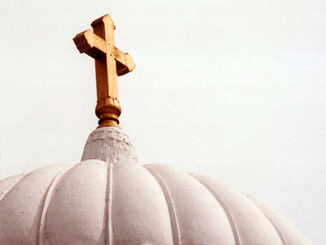
All-Saints Church
22 Sep 2013
Notes:
Our thoughts today turn to seven weeks ago from this day to All-Saints Church.

Slide 4
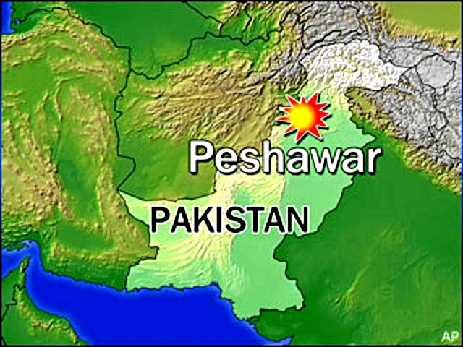
All-Saints Church
22 Sep 2013
Notes:
The church is located in the northern region of Pakistan in the city of Peshawar, close to the border with Afghanistan.

Slide 5
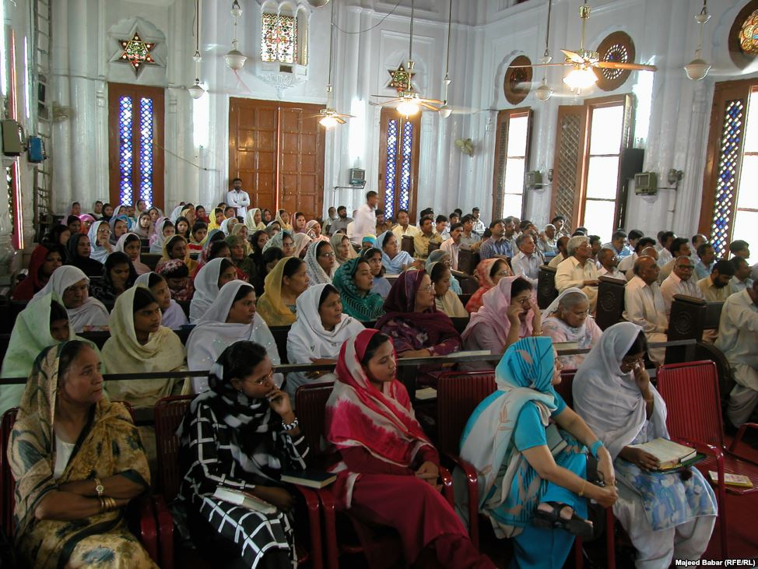
All-Saints Church
22 Sep 2013
Notes:
Inside the church it looks much like many others in that region where the men and the women sit on opposite sides.

Slide 6
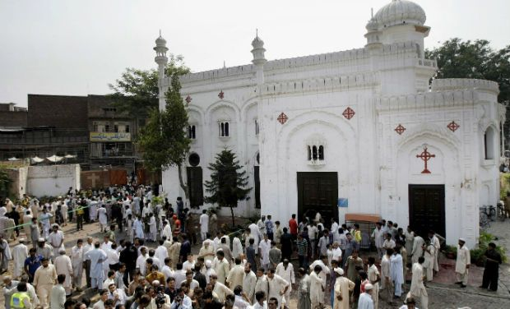
All-Saints Church
22 Sep 2013
Notes:
On 22 September 2013 after the service the believers gathered outside the building in the courtyard to talk, to eat—over 200 men, women, and children.

Slide 7
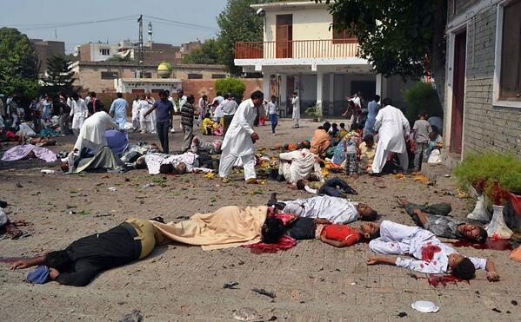
All-Saints Church
22 Sep 2013
Notes:
Infiltrating the crowd were two suicide bombers, who struck the All Saints Church members after their service that Sunday, killing more more than 90 people and wounding more than 150. The victims included many children.

Slide 8
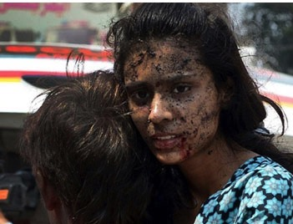
All-Saints Church
22 Sep 2013
Notes:
None of us can imagine the horror of that moment.

Slide 9
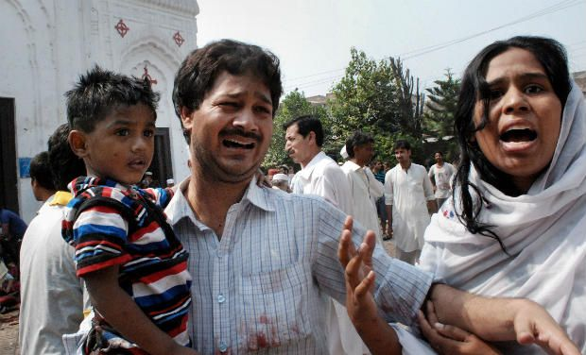
All-Saints Church
22 Sep 2013
Notes:
None of us can.

Slide 10
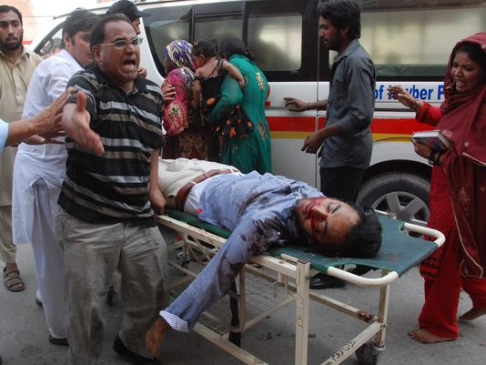
All-Saints Church
22 Sep 2013
Notes:
A wing of the Pakistani Taliban claimed responsibility for the bombing, saying it would continue to target non-Muslims until the United States stopped drone attacks in the country's remote tribal region.

Slide 11
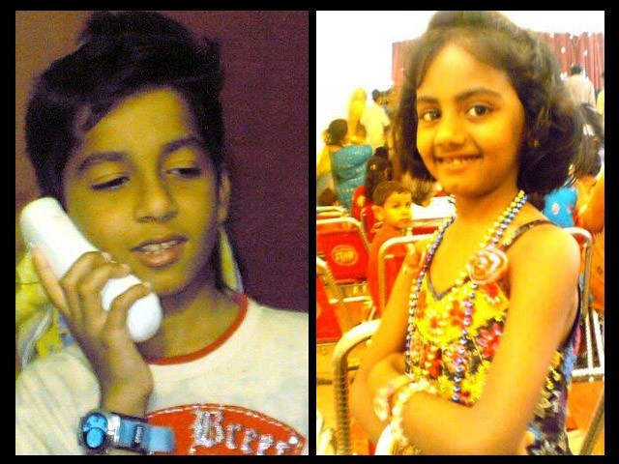
Eshaan & Neha
Notes:
The saddest part of the story concerns the children. The father of Eshaan and Neha was on business in the US at the time, but later wrote, "As he did after every Sunday mass, Eshaan was playing near the church gate with his friends. Little was he to know that this was the last time he would pray in church, play with his friends, tease his sister or hug his mother. His head was ripped off by the blast and his sister Neha, who was running after him at the time, was so traumatised by the sight that her little heart gave in and she collapsed next to Eshaan’s torn body."
Full article:
"The twin bombs that exploded on Sunday at All Saints Church, Peshawar, killed more than 90 people, injured nearly 150 others, and emotionally scarred thousands more.
Investigations are under way while recovery and treatment has begun for the injured and their families. For some, healing will be swift while others may take small steps over months, maybe even years. Many more might never fully recover from this tragedy.
The most heartbreaking of this and such tragedies is the number of young lives lost in these attacks. Since the blast took place on Sunday, the All Saints Church was packed to the brim with Christians from the locality; many of them students, volunteers, youth leaders, activists and Sunday school children. These were children we all knew, if not in person, at least by face. Even now as I close my eyes, I can visualise the happy little angels skipping through the church doors.
It is therefore, with great sorrow and a heavy heart that I share my memories of Neha and Eshaan.
Since the blast, I have not had a moment’s peace as I keep remembering how they used to make me laugh at their playful antics. Today I realised that the only way to alleviate my pain, even if a little bit, is by sharing their story.
These little victims of the senseless violence that rocked Peshawar in general and the Christian community in particular, were gems treasured by their parents, family, friends and teachers alike.
As he did after every Sunday mass, Eshaan was playing near the church gate with his friends. Little was he to know that this was the last time he would pray in church, play with his friends, tease his sister or hug his mother. His head was ripped off by the blast and his sister Neha, who was running after him at the time, was so traumatised by the sight that her little heart gave in and she collapsed next to Eshaan’s torn body.
I cannot even begin to imagine what Eshaan and Neha’s parents must be feeling right now. I can’t imagine the horror that any parent would feel upon hearing such news – that their two young children, the apples of their eyes, the stars in their life – are no more. There can be nothing more traumatic than raising your children, caring for them, loving them and already dreaming of their future only to have them ripped away from you.
In Eshaan and Neha’s case, the situation was worsened because their father, Insar, was in the United States at the time of the blast. In a cracked voice, he said over the phone,
“They were little angels sent down to me to love and protect. Like most fathers, I was often over-protective and sometimes downright clingy. After all, my children were my treasure.”
His voice completely broke then, and all we heard for a few minutes was the heart-wrenching weeping of a man in physical and emotional trauma. Mustering up his strength, he said,
“No parent should ever have to encounter a day like today; no parent should ever have to hear the words that your child is no more. Parents are never prepared to lose their children, not even children who have a terminal illness. Then how do I deal with something I did not even have an inkling of?”
After every few minutes of crying and talking about his children, he repeated, almost like a mantra,
“If only I was in Pakistan.”
While their father is in the US and has not been able to catch a flight back home yet, their mother, Uzma, is in the Intensive Care Unit (ICU). She still has no idea of what happened to her children.
Remembering his children, Insar says,
“Children change our life. They show us new ways to love, new things to find joy in, and new ways to look at the world.”
However, for Insar and Uzma the world has become dark and empty. This one incident has taken the light of their lives away and every room, every toy, every scribble will bring back painful memories. Their only wish will be to turn back time and see their children one last time, hold them tight and kiss their glowing faces. There will be times when getting through the day will feel like torture.
All we can do is pray that with time, these memories will become less painful and that one day, Insar and Uzma will begin to re-build their lives. We hope that they will learn to carry with them, happy memories of the love they shared with their precious children, even if it was for such a short time.
http://blogs.tribune.com.pk/story/18971/they-were-just-children-not-christian-children/

Slide 12
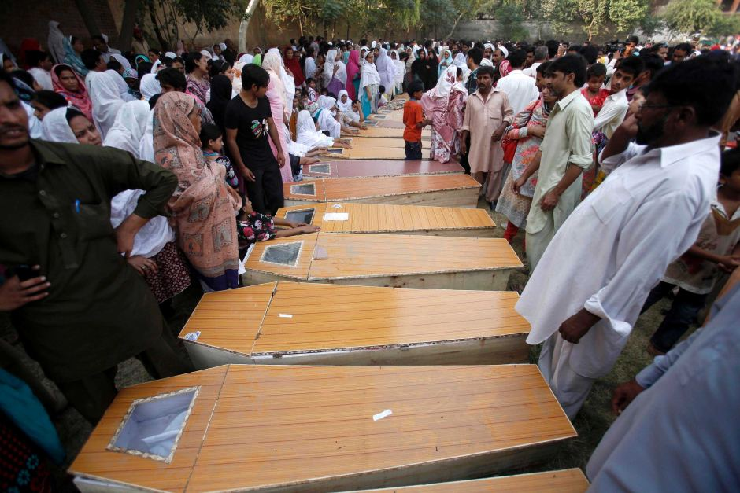
All-Saints Church
90 killed
150 wounded
13 widows
36 orphans
53 families lost bread winners
Notes:
The toll on a single assembly is staggering!

Slide 13
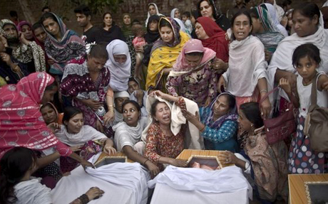
All-Saints Church
22 Sep 2013
Notes:
The grief is unimaginable.

Slide 14
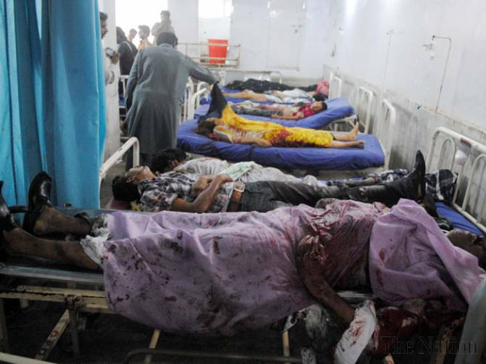
All-Saints Church
Doctors Absent
Notes:
The tragedy was compounded by the fact that the local hospital could not handle the crisis primarily because local doctors and paramedics refused to come to the hospital to treat the Christians—not until the local political leader ordered them to come or their jobs would be on the line.
Full article:
PESHAWAR - Death toll from Sunday’s twin bombings at All Saints Church was horrendous and Lady Reading Hospital was running out of caskets, beds and medicine for the wounded; and on top of that doctors and paramedics were absent. To give vent to their anger over sorry state of affairs at the public health centre, attendants of the injured ransacked the hospital and chanted slogans against Khyber Pakhtunkhwa government for its inability to ensure every sort of health facility during the emergency situation. Insufficient number of doctors and nurses was present at the hospital that could hardly provide first aid treatment to over 100 injured ferried from the blast site. Despite the fact that an emergency was declared, most of the doctors remained absent from their duties. It came as a shock to learn that a provincial government so willing to provide free of cost treatment and medicines slipped on ensuring hassle-free health services. As a result, most of the injured could not get medical aid in a timely manner, while many of the injured had to lie down across the floor due to shortage of beds. Nevertheless, when Pakistan Tehreek-e-Insaf chief Imran Khan came in, most of the doctors had to pull up their socks in order to save their skin. People from different walks of life criticised PTI-led provincial government for its poor performance and asked it to provide all sort of health facilities to the injured. They also demanded stern action against the negligent doctors.
http://www.nation.com.pk/pakistan-news-newspaper-daily-english-online/national/23-Sep-2013/peshawar-hospital-ransacked-for-absence-of-docs-facilities

Slide 15
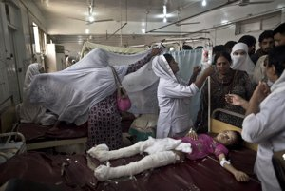
All-Saints Church
22 Sep 2013
Notes:
So they did, but it was too late for some of the victims who needed immediate care to save their lives.

Slide 16
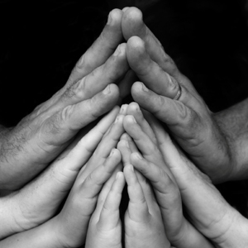
In what area are you "taking hits" for your faith in Christ?
Notes:
You workplace passes you up for promotion.
Your motives are misunderstood.
You are lumped with fanatics.
Your faith is ridiculed in your family.
Some other area?

Slide 17
How does Jesus want you to respond to suffering?
Notes:
What is most important is Christ's view of suffering—how he wants us to address it!

Slide 18
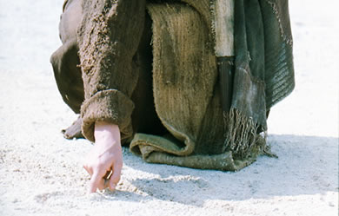
Christ's Writing Ministry
Notes:
We have NO actual accounts of Jesus writing anything except what he wrote in the sand in John 8—and we have no idea what he wrote!

Slide 19
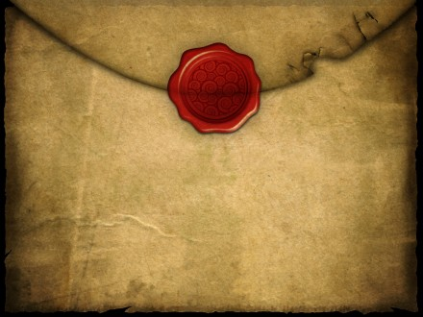
If Jesus wrote a letter to our church, what would Jesus say?
R
Revelation
Notes:
We speak of WWJD (What Would Jesus Do)
However, I am addressing WWJS

Slide 20
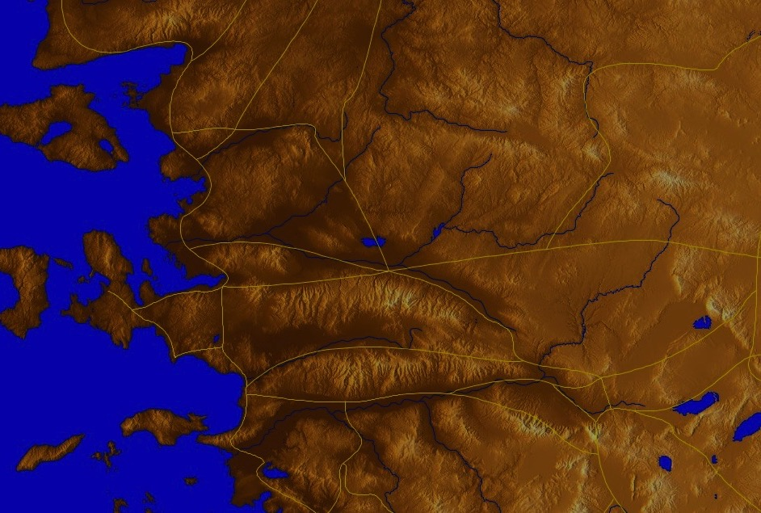
Asia Minor in AD 95
345
Adramyttium
Aezani
Cyme
Erythrae
Eumenia
Lebedus
Colophon
Nysa
Hierapolis
Trailes
Heraclea
Aphrodisias
Colossae
Alabanda
Patmos
Miletus
Notes:
In AD 95 John was exiled to the lonely island of Patmos out in the Adriatic Sea. Jesus Christ had a revelation of comfort to the suffering believers of Asia Minor, but how could this message reach them?

Slide 21
The 7 Churches (Rev. 2–3)
345
Adramyttium
Aezani
Pergamum
Thyatira
Cyme
Erythrae
Sardis
Smyrna
Eumenia
Philadelphia
Lebedus
Colophon
Ephesus
Nysa
Laodicea
Hierapolis
Trailes
Heraclea
Aphrodisias
Colossae
Alabanda
Patmos
Miletus
Notes:
Jesus designed a brilliant strategy by having his revelation sent to capital of the province, Ephesus. It included an individual letter to Ephesus, as well as letters to 6 other key churches. The Ephesians copied the entire book of Revelation, though, and sent the original to the next city, Smyrna. Smyrna then made their own copy and sent the original to Pergamum, which lay on the main road to the north. This city then sent the prophecy to Thyatira, which sent it to Sardis, then Philadelphia, and finally to Laodicea.

Slide 22
The 7 Churches (Rev. 2–3)
345
Pergamum
Thyatira
Sardis
Smyrna
Philadelphia
Ephesus
Laodicea
Notes:
These 7 churches were neither the largest, nor the most influential cities in Asia Minor. However, they were strategically located on a key highway that linked them all.
[Animate} From their own locations we understand that they also copied the prophecy and sent these copies to other churches near them.

Slide 23
What are the 7 Stars & 7 Lampstands (1:20 NLT)?
"This is the meaning of the mystery of the seven stars you saw in my right hand and the seven gold lampstands: The seven stars are the angels of the seven churches, and the seven lampstands are the seven churches."
Notes:
Each church was supposed to be a light or lampstand in its locality.
How were they each doing at lighting up their world?

Slide 24
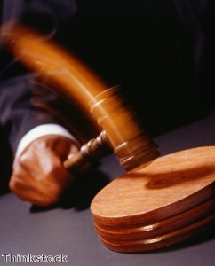
Christ has authority over all churches
344
Notes:
The point of Revelation 2–3 is that Jesus has authority over all churches

Slide 25
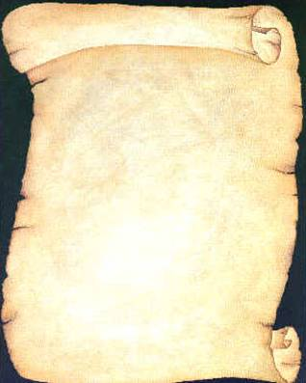
So Jesus wrote 7 churches (Rev. 2–3)
Ephesus
Smyrna
Pergamum
Thyatira
Sardis
Philadelphia
Laodicea

Slide 26
Revelation
Sovereignty of Christ in Future Victory
Sovereignty in His Person |  |  | Sovereignty over Churches | Sovereignty in End-Time Events
Chapter 1 |  |  | Chapters 2–3 | Chapters 4–22
"What you have seen" (1:19a) |  |  | "What is now" (1:19b) | "What will take place later" (1:19c)
Past |  |  | Present | Future
Christ Unveiled |  |  | Churches Unveiled | Consummation Unveiled
God on Earth |  |  | God's Ambassadors on Earth | Hell on Earth to Heaven on Earth
The Judge |  |  | The Assignments | The Judgments & Rewards
Subject 1:1-3 | Worship of Trinity 1:4-8 | Glorified Christ 1:9-20 | Seven Churches of Asia: Ephesus Smyrna Pergamum Thyatira Sardis Philadelphia Laodicea | Tribulation 4:1–19:10 | Second Coming 19:11-21 | Millennium 20 | Eternal State 21:1–22:5 | Closing: Imminency 22:6-21
AD 95
318, 324 M
Notes:
These three chapters comprise the middle section of the book of Revelation in the sense in which John was to record "what he had seen" (1:19a, shown in the chapter 1 vision of Christ), followed by "what is now" (1:19b), or what was happening at the present time around AD 95 among these churches of Asia, in modern-day western Turkey.

Slide 27
The 7 Churches (Rev. 2–3)
Promise
348
Pergamum
Warning
Thyatira
Exhortation
Rebuke
Commendation
Smyrna
Sardis
N/A
Christ
N/A
N/A
N/A
Ephesus
Philadelphia
N/A
Laodicea
Notes:
Though some exceptions exist (noted with “N/A” above), the basic pattern of the seven letters is a sevenfold outline:
Church name
Christ Described in a Unique Way for that Church
Commendation of Good Deeds among the Believers
Rebuke of Sin within the Church
Exhortation or Encouragement to Repent
Warning if the Exhortation is Disobeyed or a warning to prepare them for difficulties
Promise for Faithfulness
Notice also that each letter not only begins with a reference to Christ but ends with an appeal from the Spirit.

Slide 28
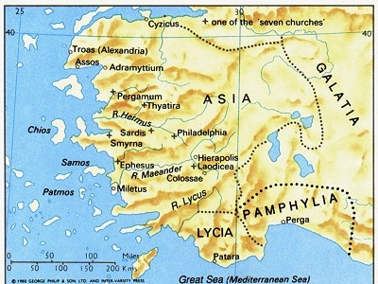
Ephesus was the capital of Asia
176
Notes:
The first letter was sent to Ephesus, which we covered last week.

Slide 29
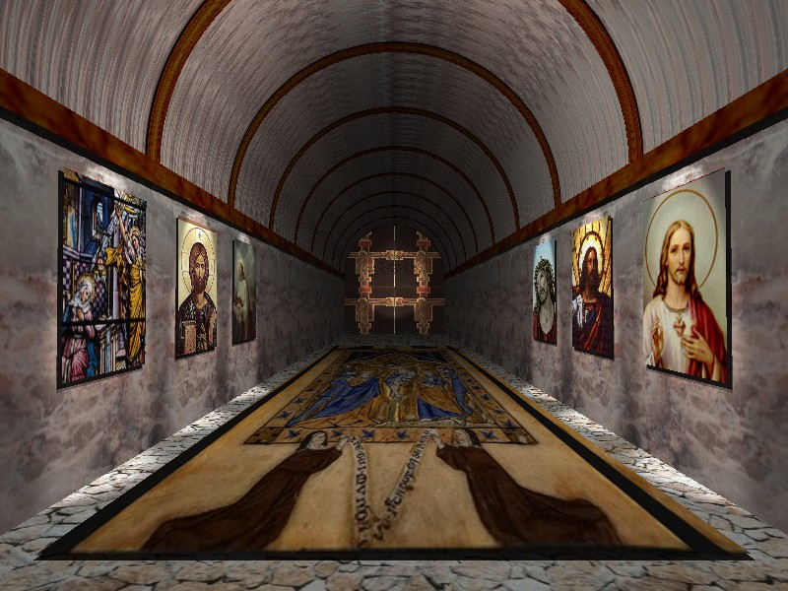
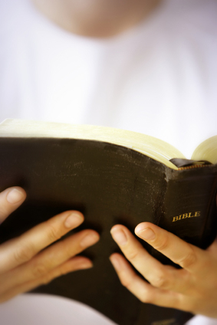
Revelation 2:4 (NIV)
Ephesus: Busy Yet Backslidden
Yet I hold this against you:
You have forsaken your first love.
Notes:
Despite the many things the Ephesian church did right in their service for Christ, they were "busy but backslidden."

Slide 30
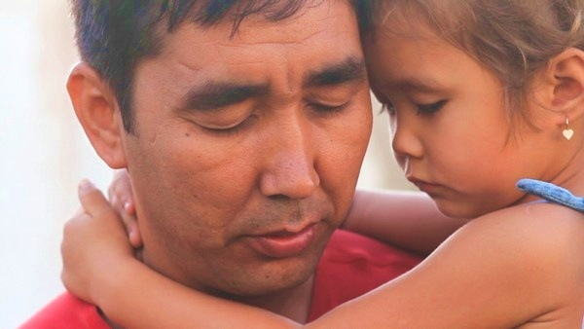
How can we handle suffering? Christ gave Smyrna three ways.
Notes:
So today we come to the second letter, written to believers in Smyrna. This letter addresses this question…

Slide 31
I. Recognize that Christ understands your suffering (2:8-9)
Notes:
Know that Jesus has "been there, done that."

Slide 32
The 7 Churches (Rev. 2–3)
345
Adramyttium
Aezani
Pergamum
Thyatira
Cyme
Erythrae
Sardis
Smyrna
Eumenia
Philadelphia
Lebedus
Colophon
Ephesus
Nysa
Laodicea
Hierapolis
Trailes
Heraclea
Aphrodisias
Colossae
Alabanda
Patmos
Miletus
Notes:
Smyrna was a seaport city like Ephesus, about 35 miles north. It still exists today with the name of Izmir.

Slide 33
Smyrna (Rev. 2:8-11)
351
Pergamum
Thyatira
Rebuke
None!
Commendation:
Suffers persecution and poverty
Christ: The First and the Last, who died and came to life again
Smyrna
Sardis
Ephesus
Philadelphia
Laodicea

Slide 34
Thank Christ that he understands your own area of suffering

Slide 35
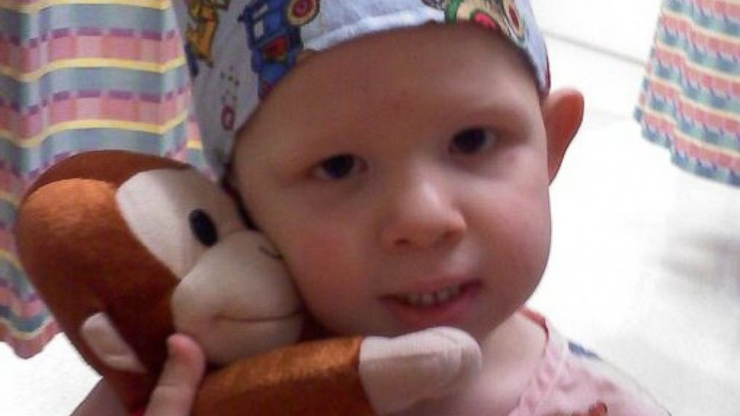
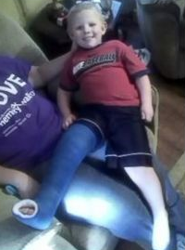
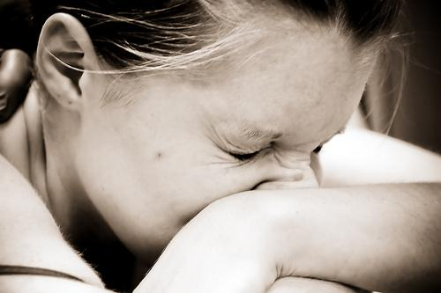
Isaac Brown The Boy Who Feels NO Pain
http://abcnews.go.com/Health/meet-toddler-feels-pain/story?id=20658484
Notes:
Is pain good? Most of us do not think so!
• Isaac
Little Isaac Brown is five years old. Like other kids his age, he's learning to read and write his ABCs and to calculate simple addition and subtraction. But there is one thing Isaac is learning that rare few other children will ever have to learn. Isaac is learning about pain.
"We're doing the best we can to just teach him; he knows blood is bad," said Brown. "We taught him even when he was little to say 'ow.' You don't have to tell normal kids to say 'ow.'"
• Baby
Isaac was born with an extremely rare genetic insensitivity to pain. Like a modern day leper, Isaac doesn't know when he's touching a hot stove, when he's stepped on broken glass, or when he's broken a bone. For example, he broke his pelvis and felt no pain at all.
• Leg
Because he doesn't feel injuries, Isaac's parents, Carrie and Randy Brown, are teaching him how to identify them to stay healthy.

Slide 36
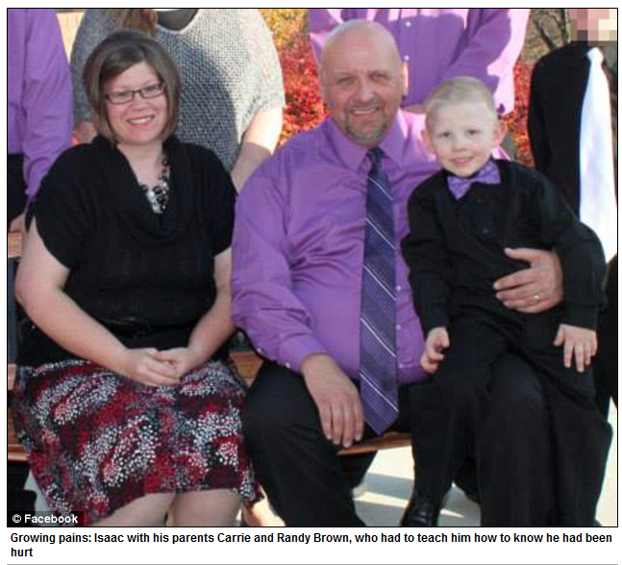
Isaac Brown The Boy Who Feels NO Pain
"When he was diagnosed, [doctors said] there's nothing we can do for Isaac, not yet anyway," [his mother] Carrie recalled. "But the fact that they can take his mutated gene and cause people with chronic pain to feel less pain. The thought of that is unreal…. God gave us Isaac, maybe for this very purpose."
http://www.medicaldaily.com/can-boy-who-feels-no-pain-help-chronic-pain-sufferers-261005
Notes:
Family
"The toddler years were an absolute nightmare," said Isaac's mother, Carrie Brown. "He would just drop to the ground and smack his face on the table. He thought the fall was fun."
Isaac has dunked his hand in hot coffee without flinching. He once placed his palm on a working oven burner without shedding a tear.
His parents are believers. His mother noted..
Read quote

Slide 37
Reasons for Suffering
John Walvoord, "Revelation," in The Bible Knowledge Commentary, 2:935
“Suffering can be expected for the ungodly, but why should the godly suffer? The Scriptures give a number of reasons. Suffering may be:
disciplinary (1 Cor. 11:30-32; Heb. 12:3-13),
preventive (as Paul’s thorn in the flesh, 2 Cor. 12:7),
the learning of obedience (as Christ’s suffering, Heb. 5:8; cf. Rom. 5:3-5), or
the providing of a better testimony for Christ (as in Acts 9:16).”

Slide 38
Christ feels your pain.

Slide 39
I. Recognize that Christ understands your suffering (2:8-9)

Slide 40
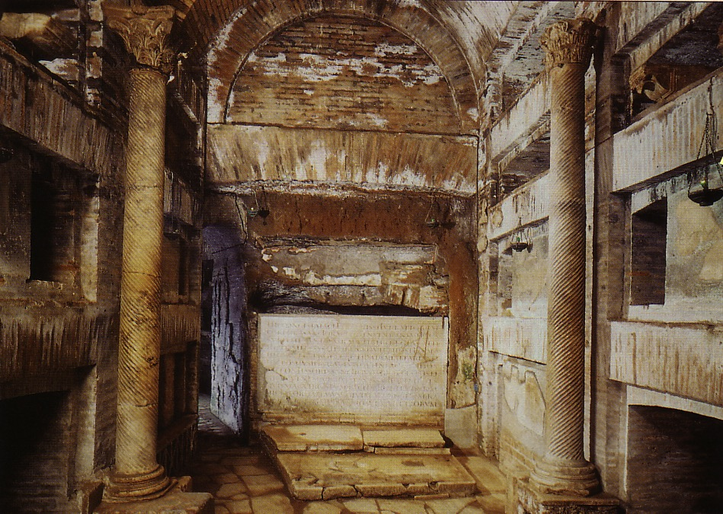
II. Don't fear suffering for Christ (2:10a)
Notes:
During Nero's persecutions Christians refused to stop worshipping Christ, so they held their services underground in the tombs beneath Rome.

Slide 41
Smyrna (Rev. 2:8-11)
351
Pergamum
Thyatira
Exhortation
Do not be afraid.
Rebuke
None!
Commendation:
Suffers persecution and poverty
Christ: The First and the Last, who died and came to life again
Smyrna
Sardis
Ephesus
Philadelphia
Laodicea

Slide 42
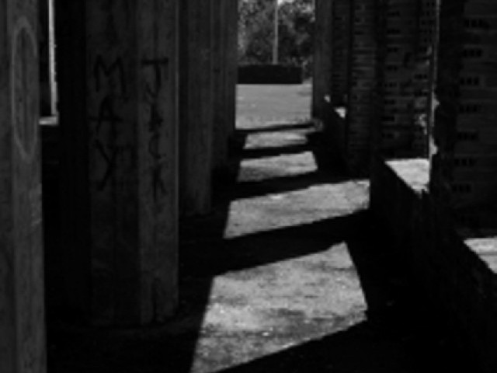
Who fears more?
Persecutors?
Persecuted?
"Do not fear what they [persecutors] fear…" (1 Peter 3:4b)

Slide 43
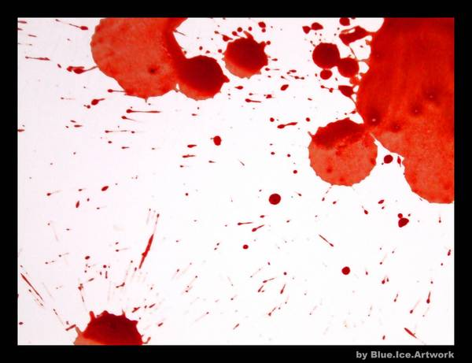
Giving
"…and if I give my body to be burned but have not love, I am nothing…" (1 Cor. 13:3 NIV)
"The Blood of the Martyrs is the seed of the Church" -Tertullian-

Slide 44
All-Saints Church
Responses

Slide 45
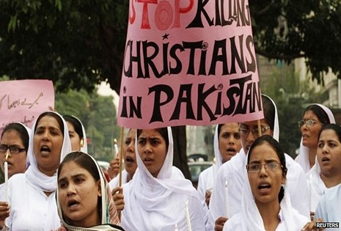
All-Saints Church
Responses can stem from fear

Slide 46
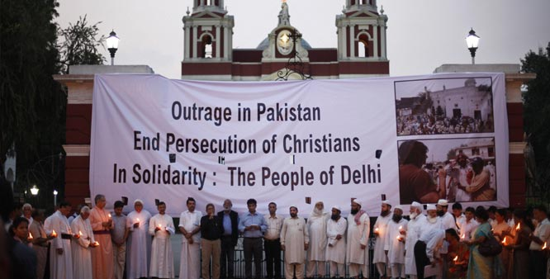
Indian Christians Call to End Relations with Pakistan
Political Responses
Notes:
Indian Christians burn Pakistan’s flag to protest church attack in Peshawar - See more at: http://post.jagran.com/christians-burn-pakistans-flag-to-protest-church-attack-in-peshawar-1380097718#sthash.drVPwCB0.dpuf

Slide 47
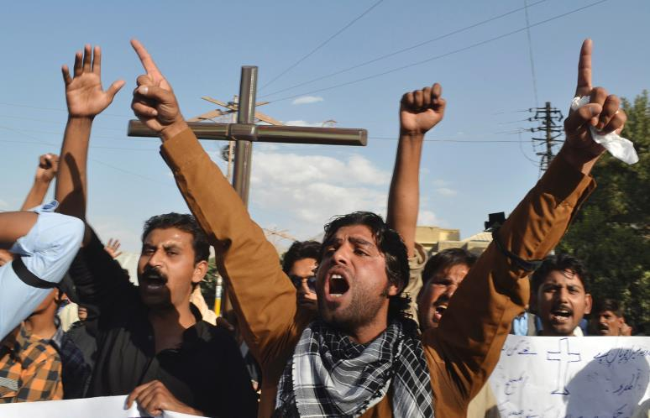
All-Saints Church
Responses of Anger

Slide 48
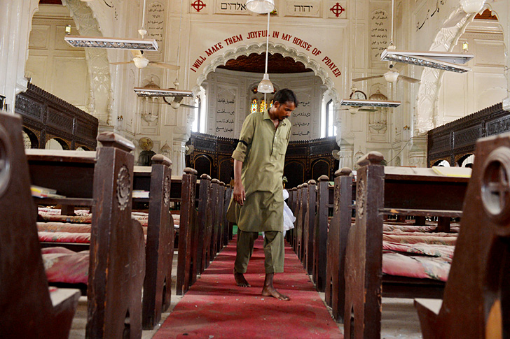
All-Saints Church
22 Sep 2013
Notes:
Note the large words in English that the people of All Saints read prior to their martyrdom or suffering in the courtyard

Slide 49
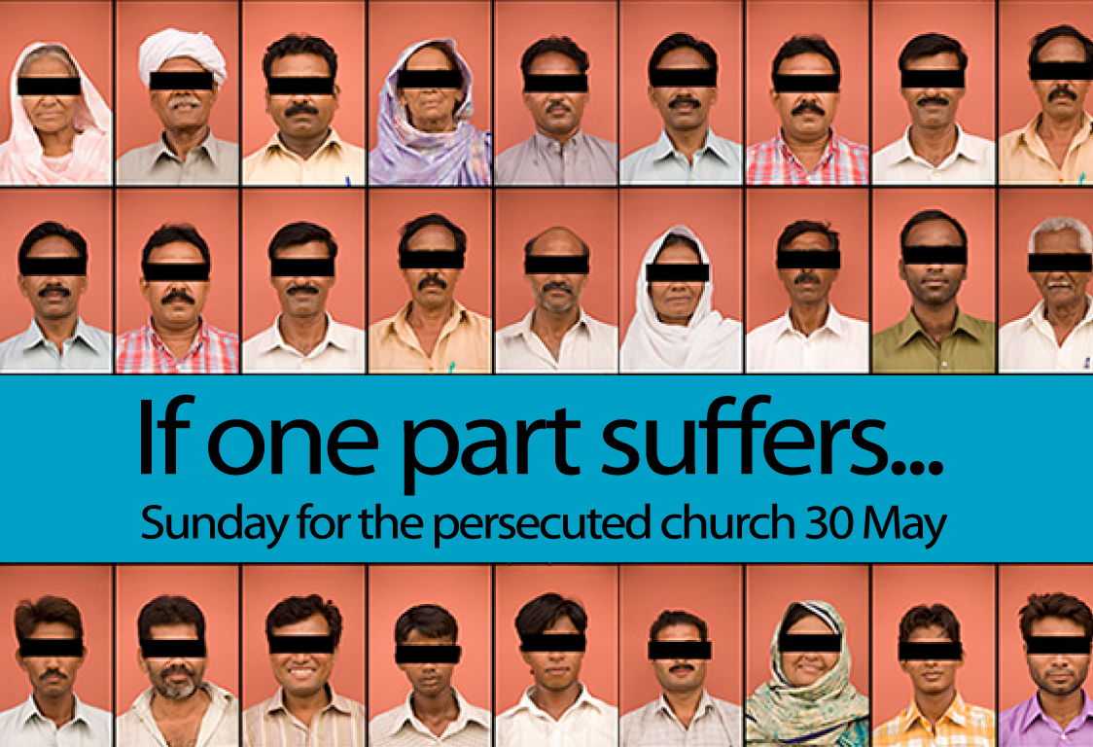
Our Response
Notes:
We have committed S$3000 to help 6 families who lost their bread winners for three months.

Slide 50
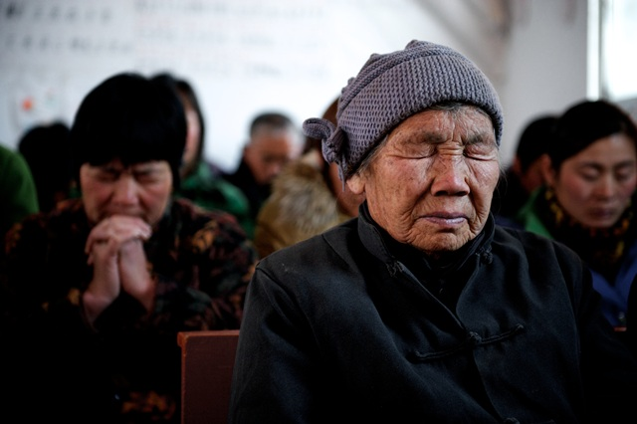
Will you confess your fear of suffering right now?

Slide 51
I. Recognize that Christ understands your suffering (2:8-9)

Slide 52
II. Don't fear suffering for Christ (2:10a)
Notes:
During Nero's persecutions Christians refused to stop worshipping Christ, so they held their services underground in the tombs beneath Rome.

Slide 53
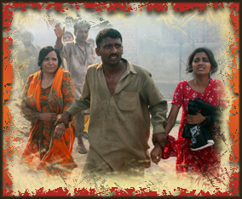
III. Be faithful during suffering (2:10b-11).
Notes:
Commit now not to waver or give up your faith due to persecution.

Slide 54
Smyrna (Rev. 2:8-11)
351
Pergamum
Thyatira
Exhortation
Do not be afraid.
Be faithful, even to the point of death
Rebuke
None!
Commendation:
Suffers persecution and poverty
Christ: The First and the Last, who died and came to life again
Smyrna
Sardis
Ephesus
Philadelphia
Laodicea

Slide 55
Smyrna (Rev. 2:8-11)
351
Warning
The devil will throw some of you into prison and you will suffer for 10 days
Thyatira
Pergamum
Exhortation
Do not be afraid.
Be faithful, even to the point of death
Rebuke
None!
Commendation:
Suffers persecution and poverty
Christ: The First and the Last, who died and came to life again
Smyrna
Sardis
Ephesus
Philadelphia
Laodicea

Slide 56
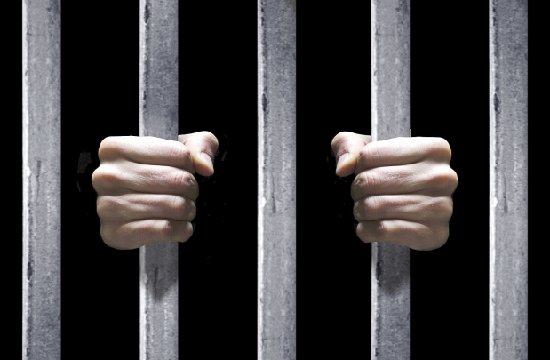
Smyrna: Suffering Yet Steadfast
"The devil will throw some of you into prison and test you for 10 days" (2:10b)

Slide 57
Smyrna (Rev. 2:8-11)
351
Pergamum
Thyatira
Exhortation
Do not be afraid.
Be faithful, even to the point of death
Rebuke
None!
Commendation:
Suffers persecution and poverty
Christ: The First and the Last, who died and came to life again
Smyrna
Sardis
Ephesus
Philadelphia
Laodicea

Slide 58
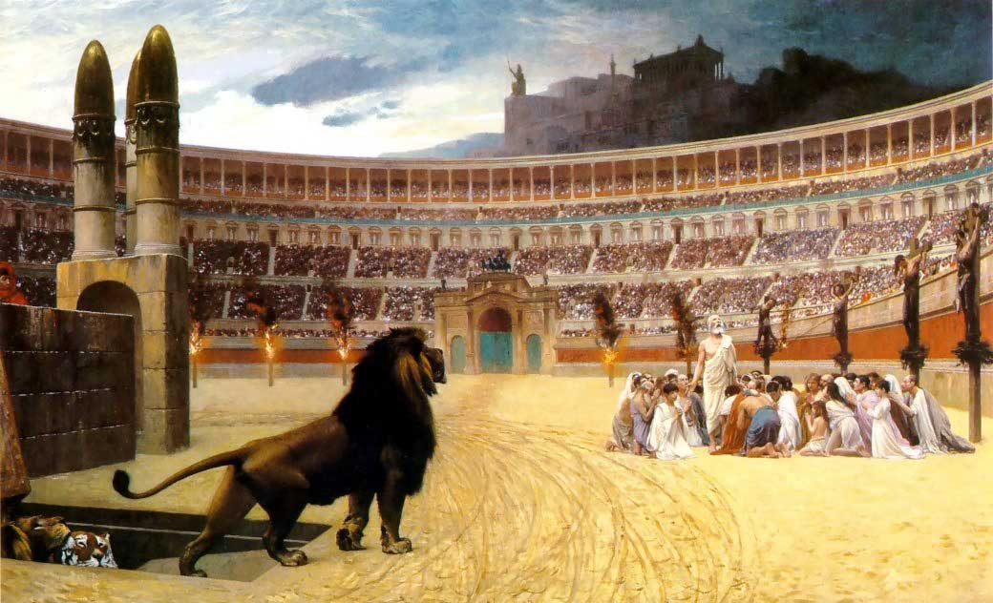
“Be faithful until death” (2:10c)

Slide 59
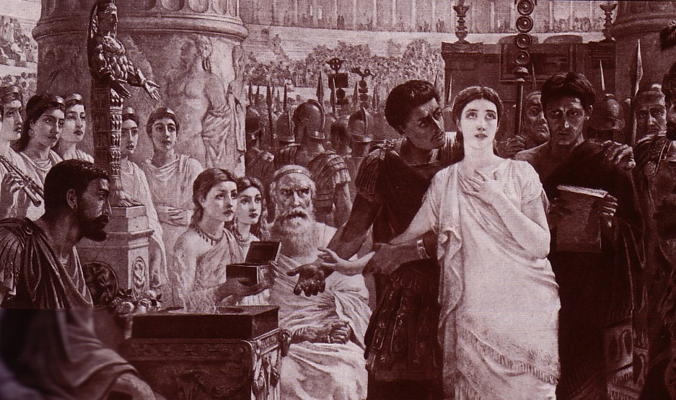
Perpetua's Martyrdom (AD 203)
352
Notes:
She refused to offer incense to Diana's image and thus was killed for it.

Slide 60
ENDA
How the issue is framed…
DEFEND EQUALITY
Employment Non- Discrimination Act
Notes:
ENDA has been presented in the two houses of the US Congress several times in the past 40 years, each time being defeated. However, the margin of defeat is narrowing and proponents are at it again.

Slide 61
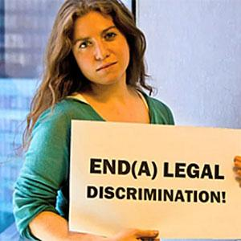
ENDA
How the issue is framed…
END(A) LEGAL DISCRIMINATION!

Slide 62
ENDA
How the issue is framed…
I SHOWER NEXT TO A GAY PERSON. YOU CAN WORK NEXT TO ONE.
PASS ENDA.

Slide 63
Most Christian conservatives oppose ENDA
STOP
THE ENDA BILL

Slide 64
Previous ENDA Exceptions
How the issue is framed…
http://www.washingtonblade.com/2013/10/30/enda-heats/
"America's Leading Gay News Source"
"Currently (30 Oct 2013), ENDA has a religious exemption that provides leeway for religious organizations, like churches or religious schools, to discriminate against LGBT employees. That same leeway isn’t found under Title VII of the Civil Rights Act of 1964, which prohibits religious organizations from discriminating on the basis of race, gender or national origin."
Notes:
Supporters have convinced people that homosexuality is not only OK, but it MUST be supported as it is as unchangeable as one’s race, gender, or national origin.
http://www.washingtonblade.com/2013/10/30/enda-heats/

Slide 65
ENDA Actual Wording
"It shall be unlawful for any employer to fail or refuse to hire or to discharge any individual, or otherwise discriminate against any individual with respect to the compensation, terms, conditions, or privileges of employment of the individual, because of such individual's actual or perceived sexual orientation or gender identity."

Slide 66
ENDA Senate Vote (5 Nov 13)
"By a 61-30 margin, the Senate cleared the last hurdle between the Employment Non-Discrimination Act (ENDA) and final passage before heading to the House. Unlike dozens of other versions, this bill takes the radical agenda a step farther by including 'gender identity' as a protected class under the law. According to 61 U.S. Senators, American schools, organizations, companies, and charities would have to swallow their concerns about safety, profits, and future business and not only encourage men to dress like women (and vice-versa) at work — but make special accommodations for them to do so."
Tony Perkins' Washington Update Family Research Council 6 Nov 2013

Slide 67
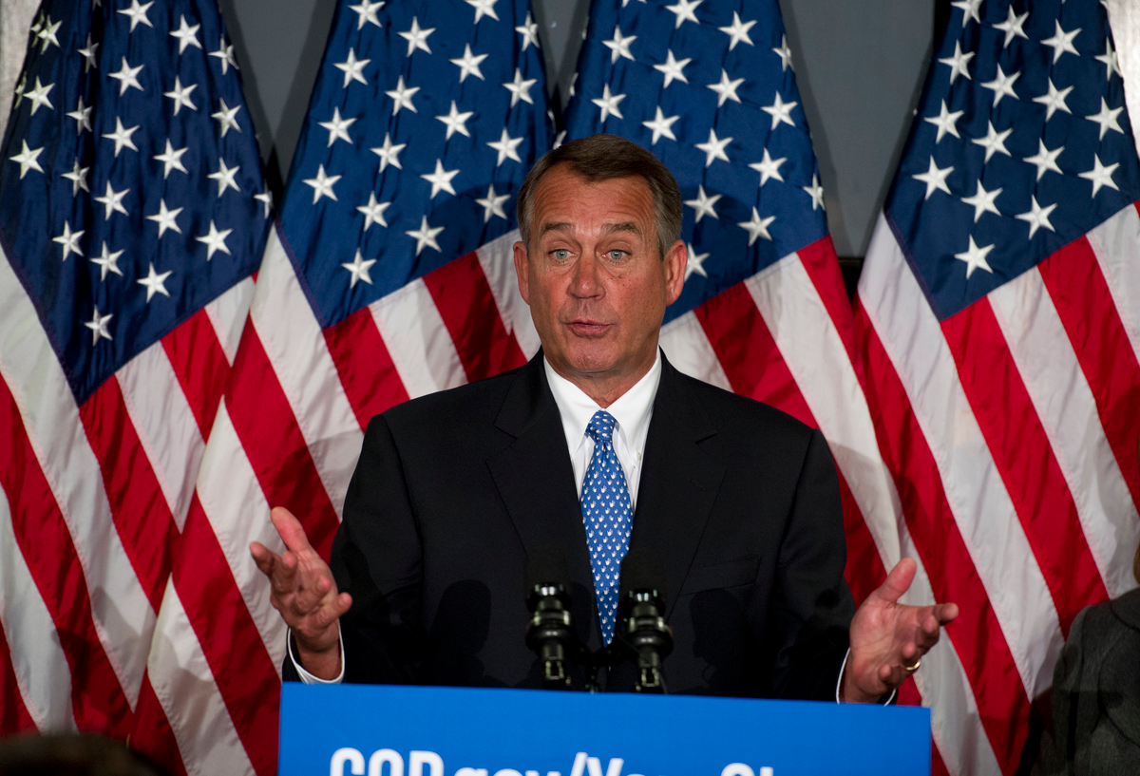
House of Representatives Speaker John Boehner Opposes ENDA
"The Speaker believes this legislation will increase frivolous litigation and cost American jobs, especially small business jobs." Boehner, his office continued, has "always believed this is covered by existing law."
Tony Perkins' Washington Update Family Research Council 7 Nov 2013

Slide 68
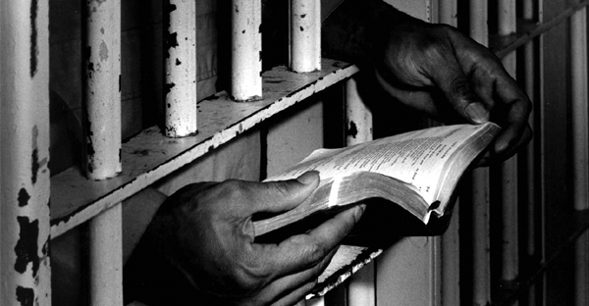
Main Idea
Replace fear with faithfulness during suffering since Jesus knows exactly how you feel
Are you ready?

Slide 69
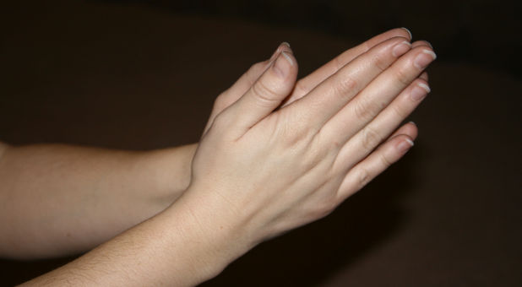
How are you suffering now?
Recognize that Jesus understands your situation.
Don’t fear suffering for Christ in this area.
Be faithful to him despite the outcome.

Slide 70
Black

Slide 71
Jesus Wins!
Series on Revelation

Slide 72
NT Sermons link at biblestudydownloads.com
Get this presentation for free!

